Slide 1

Improving the used cars market through machine learning techniques.

Slide 2
Question: What qualifies a car as used?
A used car in general term is said to be any car that has previously been registered.
- Duvan & Ozturkcan, 2009.

Slide 3
Question: What is the value and coverage of the used cars market?
The global market value of used cars was about 819.52 billion dollars in 2003 with a compound annual growth rate of 4.2% between 1999 and 2003 and the market covers the private and remarketed sales.
- Duvan & Ozturkcan, 2009.

Slide 4
Question: What are private sales?
A Private sale refers to sales when both the buyer and the seller are private individuals.
- Duvan & Ozturkcan, 2009.

Slide 5
Question: What are remarketed sales?
Remarketed sales refers to sales by companies which can be car manufacturers, car leasing or car rental companies.
- Duvan & Ozturkcan, 2009.

Slide 6
Question: Why use machine learning techniques to predict price and sales?
To resolve the issue of asymmetrical information that exist between sellers and consumers.
To verify the validity of orthodox research results on features that influence price and sales (mileage, distance covered, reliability, engine power and fuel cost) using machine learning techniques.
- Sallee et al., 2016; Yerger, 1996; Phlips, 1983; Scherer, 1996

Slide 7
Project Aim and Objectives
Finding the features that best predicts used car prices and sale probability.
Building machine learning models to predict used car prices and sale probability.
Comparing the performance of the machine learning models and detecting possible limitations that might result from individual models.

Slide 8
Project Problem Statement
Business related questions
Technical related questions
What are the features that influence car prices the most?
What are the features that influence car sales the most?
What possible facts are hidden in the data that would influence sales positively?
What model would best and least predict car prices and with what features?
Which model best and least predict the sale of a car and with what features?
Are there any other model performance related observations?

Slide 9
Methodology and Data Processing
The following steps were used to prepare my data for my machine learning tasks;
Data sourcing
Data cleaning
Exploratory data analysis
Feature extraction/engineering using KBest feature selector
Data standardisation using standard scaler and up sampling where necessary
Performance metrics and model selection
Model training
Hyperparameter optimisation
Retraining models with random forest best features selection
Comparing results and performance.

Slide 10
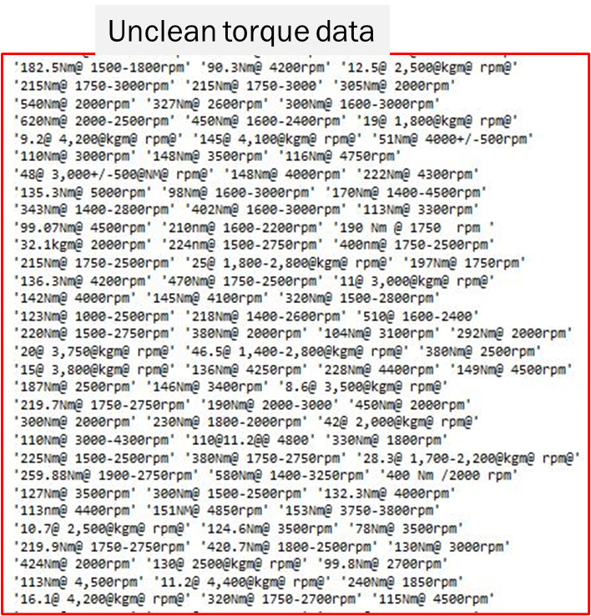
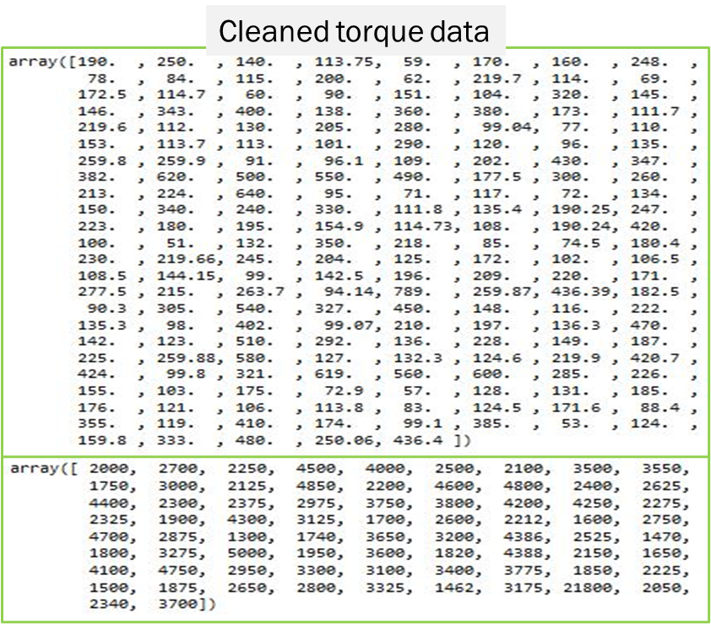
Data Cleaning

Slide 11
Methodology Summary
The dataset sourced is made up of data from the United States (US) used cars market.
The dataset consists of 18 columns namely; Sales ID, Name, Year, Selling price, Km driven, Region, State or province, City, Fuel, Seller type, Transmission, Owner, Mileage, Engine, Max power, Torque, Seats and Sold.
The dataset consists of 7,906 observations.
For the price prediction using regressors, the data was split into a ratio of 80% consisting of 5,929 observations for the training data and 20% consisting of 1977 observations for the test data.
Due to the imbalanced target in the sold column for prediction, the data was resampled to balance the data and it generated a new dataset with 11,812 observations.
For the sale prediction using classifiers, the new resampled dataset was used and was split into a ratio of 80% consisting of 9,449 observations for the training data and 20% consisting of 2,363 observations for the test data.

Slide 12
Price prediction results using regressors and KBest features
S/N | Model | R² train score (%) | R² test score (%) | MAE | MSE | RMSE | rRMSE (%) | Average. cross-val train accuracy (%) | Average cross-val test accuracy (%)
1 | Random Forest Regressor | 98.7 | 97.9 | 853.2 | 2178534.2 | 1476.0 | 11.5 | 98.8 | 97.0
2 | Linear Regressor | 62.4 | 64.0 | 3430.9 | 37644355.3 | 6135.5 | 57.2 | 62.9 | 62.8
3 | Polynomial Regressor | 85.3 | 86.2 | 2090.4 | 14484144.6 | 3805.8 | 32.3 | 85.7 | 84.0
4 | Ransac Regressor | 93.0 | 92.4 | 1096.8 | 7920226.4 | 2814.3 | 23.0 | 94.0 | 93.2
5 | SVM Regressor | 93.1 | 87.7 | 1387.5 | 12347613.2 | 3513.9 | 28.6 | 94.3 | 88.6
6 | XGBoost Regressor | 98.7 | 98.0 | 860.6 | 2049091.7 | 1431.5 | 11.1 | 98.8 | 97.1
7 | Stacked Regressor | 98.5 | 97.6 | 881.6 | 2551404.9 | 1597.3 | 12.4 | 98.4 | 96.9
8 | KNN Regressor | 98.1 | 96.9 | 1029.2 | 3281679.7 | 1811.5 | 14.1 | 98.1 | 93.1

Slide 13
Price prediction results using regressors and random forest features
S/N | Model | R² train score (%) | R² test score (%) | MAE | MSE | RMSE | rRMSE (%) | Average. cross-val train accuracy (%) | Average cross-val test accuracy (%)
1 | Random Forest Optimised Regressor | 98.9 | 97.6 | 848.0 | 2484663.6 | 1576.3 | 12.3 | 99.0 | 96.8
2 | Linear Regressor | 63.5 | 63.1 | 3453.7 | 38557269.4 | 6209.5 | 57.2 | 63.6 | 63.2
3 | Polynomial Regressor | 85.3 | 70.3 | 2237.1 | 31041586.2 | 5571.5 | 44.4 | 85.4 | 78.7
4 | Ransac Regressor | 94.7 | 94.6 | 982.4 | 5629162.1 | 2372.6 | 18.9 | 95.4 | 94.2
5 | SVM Regressor | 93.1 | 85.9 | 1507.4 | 14135702.1 | 3759.7 | 30.3 | 94.2 | 86.1
6 | XGBoost Regressor | 99.0 | 97.9 | 824.6 | 2147006.0 | 1465.3 | 11.4 | 99.1 | 97.1
7 | Stacked Regressor | 98.7 | 97.9 | 841.8 | 2211288.5 | 1487.0 | 11.5 | 98.8 | 96.9
8 | KNN Optimised Regressor | 99.8 | 85.3 | 1674.0 | 15393506.8 | 3923.5 | 31.1 | 99.8 | 84.6

Slide 14
Performance of classifier models trained with top five KBest selected sold predicting features.
S/N | Model | Training accuracy (%) | Test accuracy (%) | No. of accurately predicted test observations | No. of mislabeled test observations | F1_0 score (%) | F1_1 score (%) | Average cross-val train accuracy (%) | Average cross-val test accuracy (%)
1 | Gaussian Naive Bayes Classifier | 63.4 | 62.6 | 1478 | 885 | 53 | 69 | 63.4 | 63.3
2 | Decision Tree Classifier | 97.7 | 84.3 | 1991 | 372 | 83 | 86 | 97.9 | 81.1
3 | Random Forest Classifier | 97.7 | 86.4 | 2042 | 321 | 85 | 87 | 97.9 | 83.3
4 | Logistic Regression | 64.7 | 63.1 | 1492 | 871 | 56 | 68 | 63.9 | 63.9
5 | SVM Classifier | 65.1 | 63.1 | 1492 | 871 | 56 | 68 | 95.5 | 86.2
6 | XGBoost Classifier | 97.7 | 85.6 | 2023 | 340 | 84 | 87 | 97.9 | 83.2
7 | Stacked Classifier | 95.5 | 87.0 | 2056 | 307 | 87 | 87 | 93.2 | 85.5
8 | KNN Classifier | 96.9 | 83.9 | 1983 | 380 | 82 | 85 | 97.4 | 79.0
9 | Artificial Neural Network (ANN) | 60.8 | 60.9 | - | - | - | - | - | -

Slide 15
Confusion matrix performance report of models trained with top five KBest selected sold predicting features and 2363 test observations
S/N | Model | True Positives | False Positives | False Negatives | True Negatives
1 | Gaussian Naive Bayes Classifier | 499 | 668 | 217 | 979
2 | Decision Tree Classifier | 884 | 283 | 89 | 1107
3 | Random Forest Classifier | 922 | 245 | 76 | 1120
4 | Logistic Regression | 554 | 613 | 258 | 938
5 | SVM Classifier | 549 | 618 | 253 | 943
6 | XGBoost Classifier | 909 | 258 | 82 | 1114
7 | Stacked Classifier | 1015 | 152 | 155 | 1041
8 | KNN Classifier | 882 | 285 | 95 | 1101

Slide 16
Performance of classifier models trained with top five random forest selected sold predicting features.
S/N | Model | Training accuracy (%) | Test accuracy (%) | No. of accurately predicted test observations | No. of mislabeled test observations | F1_0 score (%) | F1_1 score (%) | Average cross-val train accuracy (%) | Average cross-val test accuracy (%)
1. | Random Forest optimised classifier | 96.0 | 94.2 | 2225 | 138 | 94 | 94 | 96.3 | 94.2
2. | XGBoost classifier | 100 | 96.2 | 2272 | 91 | 96 | 96 | 99.9 | 96.0
3. | Stacked classifier | 98.9 | 96.0 | 2263 | 100 | 96 | 96 | 99.1 | 95.5
4. | KNN optimised classifier | 100 | 94.1 | 2225 | 138 | 94 | 94 | 99.9 | 92.4
5. | Artificial Neural Network (ANN) | 93.3 | 92.2 | - | - | - | - | - | -

Slide 17
Confusion matrix performance report of models trained with top five random forest selected sold predicting features and 2363 test observations
S/N | Model | True Positives | False Positives | False Negatives | True Negatives
1 | Random Forest optimised classifier | 1041 | 137 | 1 | 1184
2 | XGBoost classifier | 1098 | 80 | 11 | 1174
3 | Stacked classifier | 1118 | 60 | 40 | 1145
4 | KNN optimised classifier | 1074 | 104 | 34 | 1151

Slide 18
Answers to business related question one and two
S/N | Orthodox Predicted Features | KBest Price Predict Features | Random Forest Price Predict Features
1. | Mileage | Torque_splitnm | Max_power
2. | Distance covered | Max_power | Year
3. | Engine power | Engine | Km_driven
4. | Fuel cost | Year | Torque_splitnm
S/N | Orthodox Predicted Features | KBest Sold Predict Features | Random Forest Sold Predict Features
1. | Mileage | Torque_splitrpm | Fuel
2. | Distance covered | Selling_price | City
3. | Engine power | Engine | Km_driven
4. | Fuel cost | State or Province | Engine
5. | Reliability | Seats | Region

Slide 19
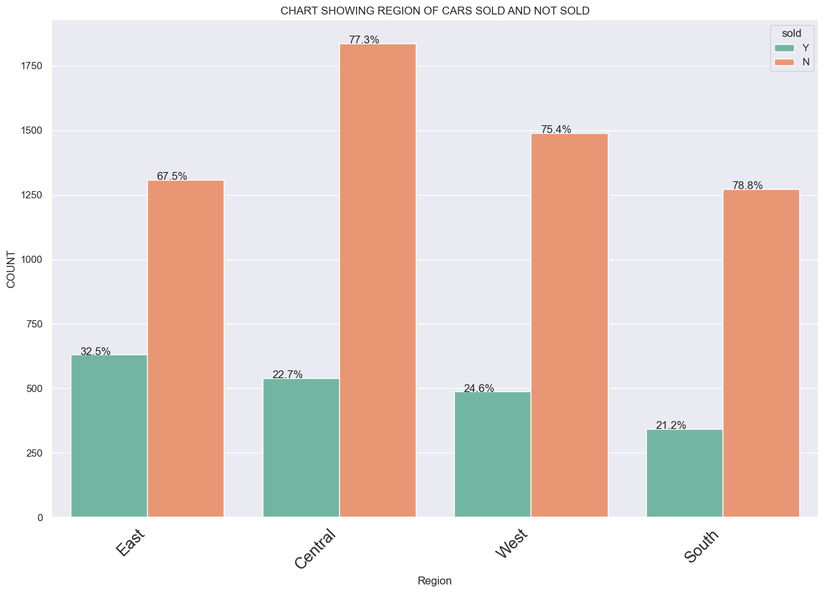
Answer to business related question three
The eastern region has the highest sale possibility with statistics showing 32.5% sold and 67.5% not-sold as shown below;

Slide 20
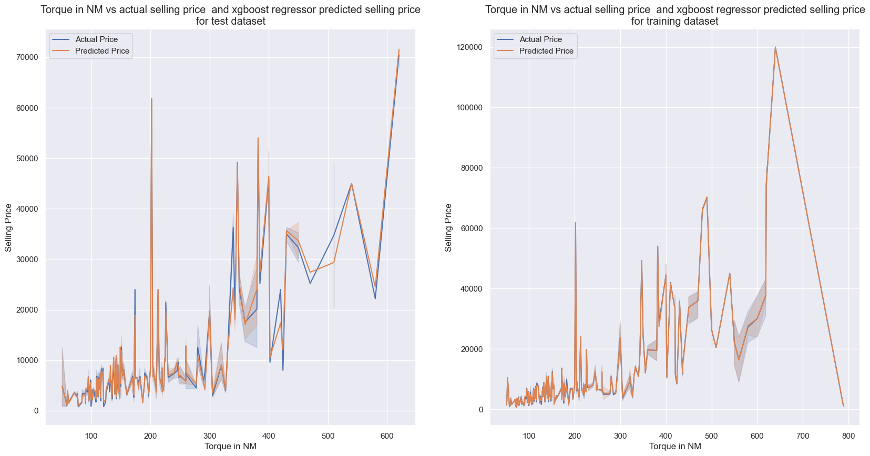
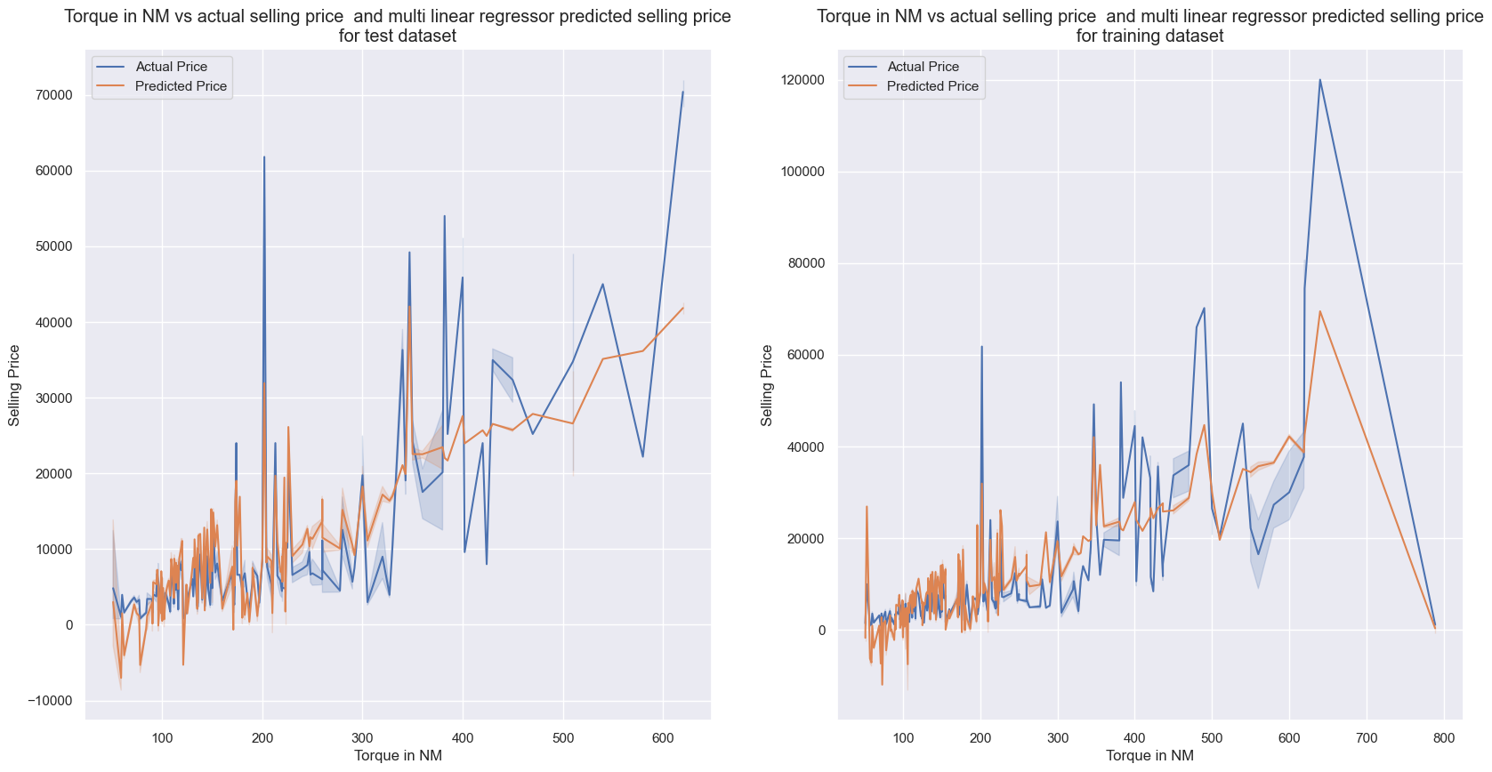
Answers to technical related question one and two
XGBoost regressor trained with KBest features was my best price predicting model while linear regressor trained with same features was my least price predicting model.
stacking classifier trained with random forest selected features was my best performing model for the binary classification task while gaussian naïve bayes trained with KBest features was my least performing model for this task.

Slide 21
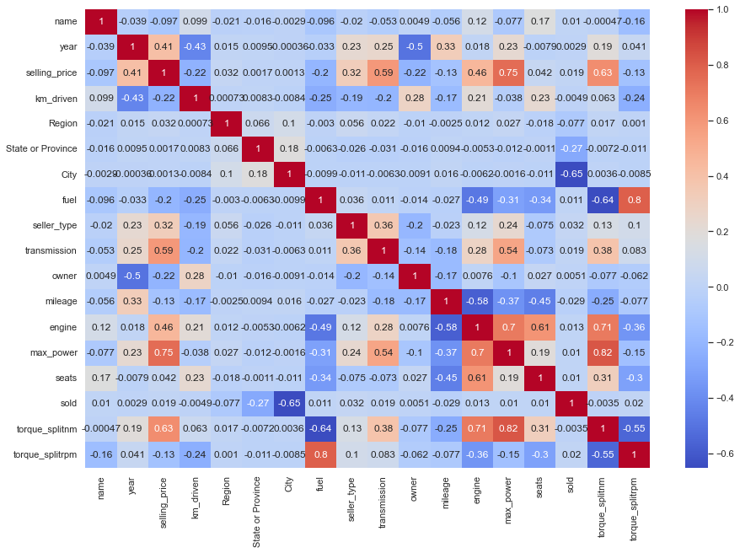
Correlation plot of the dataset

Slide 22
Answer to technical related question three
A drop in accuracies and performance of the stacking regressor trained with both KBest and random forest features when the linear regressor was removed from the group and replaced with a model of supposed better individual performance stats.
The KNN model suffers from curse of dimensionality as it performs better when trained with fewer features

Slide 23
Please ask any questions you may have.

Slide 24
Thank you for your time and attention.

Slide 25
Bibliography
Duvan, B. S. & Ozturkcan, S. (2009) Used car remarketing. International Conference on Social Sciences (ICSS).
Phlips, L. (1983) The economics of price discrimination Cambridge University Press.
Sallee, J. M., West, S. E. & Fan, W. (2016) Do consumers recognize the value of fuel economy? evidence from used car prices and gasoline price fluctuations. Journal of Public Economics, 135 61-73.
Scherer, F. M. (1996) Industry structure, strategy, and public policy Prentice Hall.
Yerger, D. B. (1996) Used car markets: Reliability does matter, but do consumer reports? Applied Economics Letters, 3 (2), 67-70.

